Slide 1
Module 1: Course Introduction
Instructor Materials
DevNet Associates v1.0
Notes:
Cisco Networking Academy Program
DevNet Associates v1.0
Module 1: Course Introduction

Slide 2
Instructor Materials – Module 1 Planning Guide
This PowerPoint deck is divided in two parts:
Instructor Planning Guide
Information to help you become familiar with the module
Teaching aids
Instructor Class Presentation
Optional slides that you can use in the classroom
Begins on slide # 8
Note: Please remove the Planning Guide from this presentation before sharing with anyone.
For additional help and resources, go to the Instructor Home Page and Course Resources for this course. You also can visit the professional development site on www.netacad.com, the official Cisco Networking Academy Facebook page, or Instructor Only FB group.
Notes:
2

Slide 3
What to Expect in this Module
To facilitate learning, the following features may be included in this module:
Feature | Description
Hands-On Labs | Labs designed for working with physical equipment.
Module Quizzes | Self-assessments that integrate concepts and skills learned throughout the series of topics presented in the module.
Videos | Expose learners to new skills and concepts.
Module Summary | Briefly recaps module content.

Slide 4
Check Your Understanding
Check Your Understanding activities are designed to let students quickly determine if they understand the content and can proceed, or if they need to review.
Check Your Understanding activities do not affect student grades.
There are no separate slides for these activities in the PPT. They are listed in the notes area of the slide that appears before these activities.
Notes:
4

Slide 5
Module 1: Activities
What activities are associated with this module?
Page # | Activity Type | Activity Name | Optional?
1.1.2 | Lab | Install the Virtual Lab Environment | Recommended
1.2.2 | Lab | Linux Review | Recommended
1.2.3 | Quiz | Linux Review | Recommended
1.3.1 | Video | The Power of Code | Recommended
1.3.3 | Lab | Python Programming Review | Recommended
1.3.4 | Quiz | Python Review | Recommended
Notes:
5

Slide 6
Module 1: Best Practices
Prior to teaching Module 1, the instructor should:
Review the activities and assessments for this module.
Try to include as many questions as possible to keep students engaged during classroom presentation.
Topic 1.1
Ask the class:
Explain the difference between a virtual machine and physical computer.
Discuss the process of installing a virtual machine on the PC and help the learners install a Virtual Machine on their PCs and use the same for performing the lab activities.
Notes:
6

Slide 7
Module 1: Best Practices (Contd.)
Topic 1.2
Discuss the things in class that run on Linux servers.
Explain the use of Linux in real life.
Topic 1.3
Have the students discuss their experiences with coding.
Discuss the benefits of Python over other programming languages.
Notes:
7

Slide 8
Module 1: Course Introduction
DevNet Associates v1.0
Notes:
Cisco Networking Academy Program
DevNet Associates v1.0
Module 1: Course Introduction
In-Session Activities / Explanations:
Time: 5 min
Instructor Notes:
Welcome the audience in a warm and cordial manner. Ensure that everyone is set up with the required resources.
Introduce yourself briefly and invite participants to introduce themselves with name, dept. and role, if deemed all right.
Introduce the topic and encourage learners to come up with a list of expectations from the session. Collate topics on the white board or Desktop while using learner’s inputs to interpret them in words.
Read out the Objectives and briefly describe each.
Key Points: NA

Slide 9
Course Introduction Course Overview
The DevNet Associate course will cover the basics of software development, networking fundamentals and automation. It will comprise of the following modules:
Understanding and Using APIs Module: In this module, you will learn about APIs, their benefits, and how to troubleshoot them.
Software Development and Design Module: In this module, you will learn the main concepts of software development and be equipped with the necessary tools to write quality code.
Network Fundamentals Module: In this module, you will learn about the basics of network, network devices, network protocols, and troubleshooting connectivity issues.
Infrastructure and Automation module: In this module, you learn to manage the infrastructure with automation, instead of manually setting up the infrastructure.
Cisco Platforms and Development: In this module, you will learn about data centers and networking including data models and security.
Notes:
9
1 – Course Introduction
1.0 – Introduction
1.0.3 – Course Overview

Slide 10
Module Objectives
Module Title: Course Introduction
Module Objective: Use basic Python programming and Linux skills.
Topic Title | Topic Objective
Your Lab Environment | Install a virtual lab environment.
Linux | Manage the Linux file system and permissions.
Python | Use basic Python programming
Notes:
10
1 – Course Introduction
1.0 – Introduction
1.0.5 – What Will I Learn to Do in this Module?

Slide 11
1.1 Your Lab Environment
Notes:
Source:
1 – Course Introduction
1.1 – Your Lab Environment
In-Session Activities / Explanations:
Time: 5 min
Instructor Notes:
Start by asking the participants if they have heard about the concept of virtual machines.
Help the participants go through the Lab exercise.
Key Points: Virtual Machines; Guest and Host Machines

Slide 12
Course Introduction Set Up Your Lab Environment
With virtualization, virtual computers can operate and run within physical computers. These computers are called Virtual Machines (VMs).
VMs are often called guests, and physical computers are often called hosts.
Anyone with a modern computer and operating system can run virtual machines.
Notes:
1 – Course Introduction
1.1 – Your Lab Environment
1.1.1 – Set Up Your Lab Environment

Slide 13
Course Introduction Lab – Install the Virtual Lab Environment
In this lab, you will complete the following objectives:
Part 1: Prepare a Computer for Virtualization
Part 2: Explore the DEVASC VM GUI
Part 3: Create Lab Environment Accounts
Part 4: Install Webex Teams on your Device
Notes:
1 – Course Introduction
1.1 – Your Lab Environment
1.1.2 – Lab – Install the Virtual Lab Environment

Slide 14
1.2 Linux
Notes:
Source:
1 – Course Introduction
1.2 – Linux
In-Session Activities / Explanations:
Time: 5 min
Instructor Notes:
Introduce the topic and highlight how Linux is used in our day-to-day lives.
By the end of the topic, enquire how the learners performed during the Linux Review Lab. If they had issues, direct them to the Linux Unhatched course listed in the Student Resources page.
Key Points: Introduction to Linux

Slide 15
Linux Linux for DevNet
Linux has gained widespread use in servers, Internet of Things (IoT) devices, networking equipment, smartphones, and many other devices that may not seem as even being computers.
All coding labs in this course are performed on a Linux-based VM.
Notes:
1 – Course Introduction
1.2 – Linux
1.2.1 – Linux for DevNet

Slide 16
Linux Lab – Linux Review
In this lab, you will complete the following objectives:
Part 1: Launch the DEVASC VM
Part 2: Review Command Syntax Navigation
Part 3: Review File Management
Part 4: Review Regular Expressions
Part 5: Review System Administration
Notes:
1 – Course Introduction
1.2 – Linux
1.2.2 – Lab – Linux Review
1.2.3 – Quiz – Linux Review

Slide 17
Linux How did you do on the Linux Review Lab?
If there was any issue with the Linux Review lab, then take the Linux Unhatched course.
The Linux Unhatched course is a free, online, and self-paced course.
Notes:
1 – Course Introduction
1.2 – Linux
1.2.4 – How did you do on the Linux Review Lab?

Slide 18
1.3 Python
Notes:
Source:
1 – Course Introduction
1.3 – Python
In-Session Activities / Explanations:
Time: 5 min
Instructor Notes:
Introduce the topic and highlight how Python is used in our day-to-day lives.
By the end of the topic, enquire how the learners performed during the Python Review Lab. If they had issues, direct them to the Python Essentials course listed in the Student Resources page.
Key Points: Introduction to Python

Slide 19
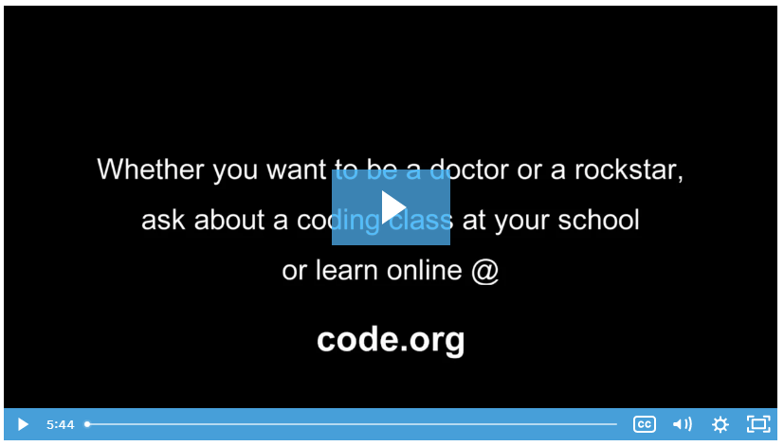
Python The Power of Code
In this video, you will view experts talking about their experiences and passion towards coding.
Notes:
1 – Course Introduction
1.3 – Python
1.3.1 – The Power of Code

Slide 20
Python Python Programming
Python is an easy to learn programming language.
Few factors that make Python a great tool for learning basic coding are:
It is easy to learn - the time needed to learn Python is shorter than for many other languages.
It is easy to use for writing new software – it is possible to write code faster when using Python.
It is easy to obtain, install and deploy - Python is free, open and multiplatform.
Python provides a solid foundation and allows to learn other programming languages (for example, C++, Java, or C) much easier and faster.
Notes:
1 – Course Introduction
1.3 – Python
1.3.2 – Python Programming

Slide 21
Python Lab - Python Programming Review
In this lab, you will complete the following objectives:
Part 1: Launch the DEVASC VM
Part 2: Start Python and VS Code
Part 3: Review Data Types and Variables
Part 4: Review Lists and Dictionaries
Part 5: Review the Input Function
Part 6: Review If, For, and While Functions
Part 7: Review Methods for File Access
Notes:
1 – Course Introduction
1.3 – Python
1.3.3 – Lab – Python Programming Review
1.3.4 – Quiz – Python Review

Slide 22
Python How did you do on the Python Programming Review Lab?
If there was any issue with the Python Programming lab, take the Python Essentials course listed in the Student Resources page.
The Python Essentials course is a free, online, and self-paced course.
Notes:
1 – Course Introduction
1.3 – Python
1.3.5 – How did you do on the Python Programming Review Lab?

Slide 23
1.4 Course Introduction Summary
Notes:
1 – Course Introduction
1.4 – Course Introduction Summary
In-Session Activities / Explanations:
Time: 5 mins
Instructor Notes:
Read out the summary points mentioned on the slide.
Discuss the same with the participants.
Ask if they have any questions or doubts.
Key Points: Course Introduction Summary

Slide 24
Course Introduction Summary What did I learn in this module?
This Course Introduction module was designed to help you prepare to take the DevNet Associate (DEVASC) course.
The Install the Virtual Lab Environment gets you and your PC ready for the coding labs you will find in this course.
The Linux Review and Python Programming Review labs help you to determine whether you are ready with the prerequisite knowledge and skills required to successfully take the DEVASC course.
Notes:
1 – Course Introduction
1.4 – Course Introduction Summary
1.4.1 – What did I learn In this Module?

